Slide 1
Bid Manager Takeoff Modernization
2021

Slide 2
Agenda
History and future of the new takeoff design
SPD Takeoff Demo
Next steps, next takeoffs
Q/A
Type your Questions in the chat menu, and raise your hand if you’d like to ask a question verbally!

Slide 3
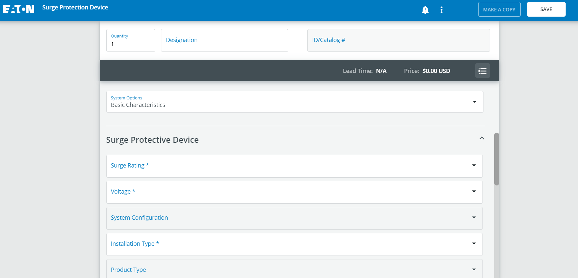
“GTO” Takeoffs are starting a makeover in 2021
Several less complex “General Takeoffs” in BidMan will get a makeover in 2021.
Modern design created with a wide range of user inputs (26hrs of interviews!)
Common user interface makes configuration easier
Key to enable Bid Manager on the web: eaton.com, Channel Sites, Order Center, CPQ, etc.
Common code base make updates faster and easier
Mobile ready*
*Bid Manager “shell” (Jobs/Pricing) has limited functions on Mobile JOE at present time. These takeoffs will be fully mobile compatible and ready.

Slide 4
SPD Takeoff showcases new design in January
Work the sections from top to bottom. Each section header can be expanded or collapsed.
Pricing easily shown from the numbered list icon
Bell icon shows important issues
Menu icon has less frequently used sections

Slide 5
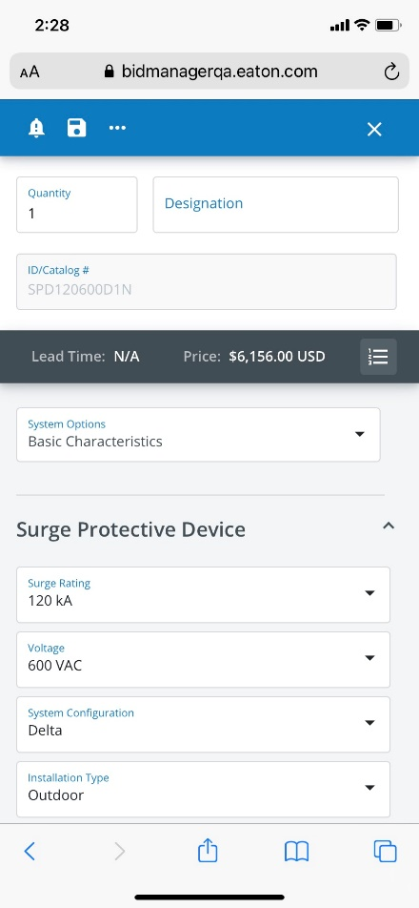
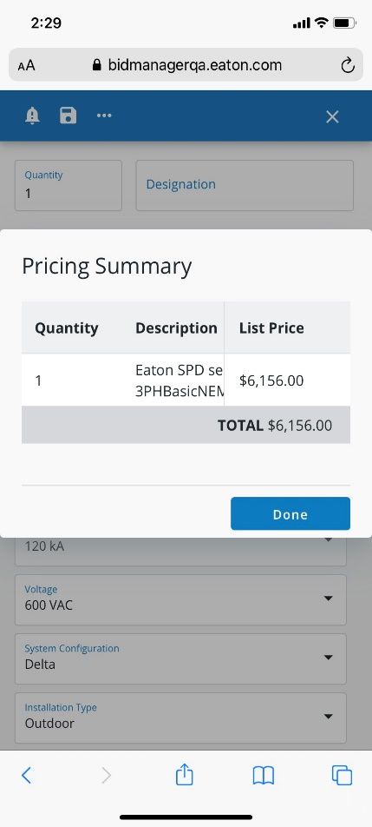
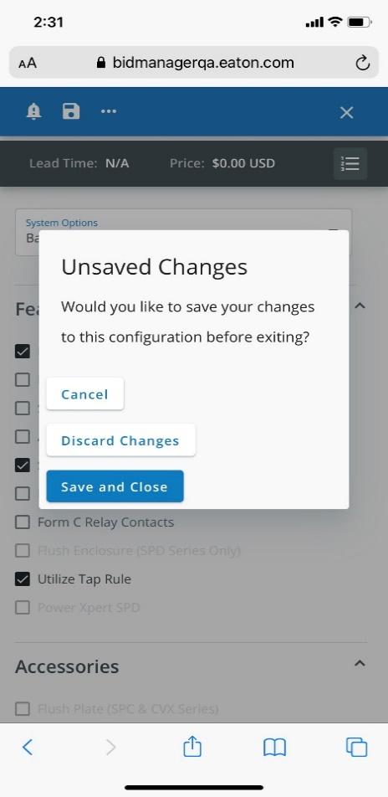
Ready for the Future: Mobile Interface
Mobile Configuration allows Eaton customers ultimate flexibility
This design will allow future takeoffs to easily configure items “anonymously” on eaton.com and distributor sites (does not apply to SPD).
Notes:
PX Blue team recommends using Angular Materials as standard and then applying PX Blue theme/icons.
Some of component styles that Bessemer has provided is not 100% match currently with Angular Materials.
PX Blue is currently on Angular Material theme version 8, testing version 10 this year.
PX Blue doesn’t have library of all standards controls and recommend to use Material design.

Slide 6
Release Timeline
January: SPD - Surge Protection Devices
April: PDMCCB - Power Defense Breakers and DRVENC - Drives – Enclosed
February: ECSW - Elevator Control Switches
March: ENCLOSC - Enclosed Control
Eventually: More General Takeoffs!

Slide 8
FAQ
What does Mobile Ready mean?
This takeoff design allows for flexibility on multiple devices (mobile, tablet, PC), and multiple platforms (Mobile JOE, eaton.com, distributor/agent websites). While Bid Manager is not fully mobile at this time, this takeoff design is mobile compatible regardless of platform.
Can we login with our Mobile devices, configure a takeoff at a customer site, and get a price?
Yes – as long as you use the takeoff features only. You can login to Mobile JOE→Bidman and use the takeoff to get a price. The “shell” of BidManager (Jobs/Alts) is not mobile friendly. However, this design will allow these configurators to launch on various other customer sites in the future.
When will the panelboard takeoff be ready?
We don't have a timeline now, but plans are underway. Keep your ears tuned for updates on a timeline soon!

Slide 9
Additional Resources
SPD Takeoff Help Guide

Slide 10
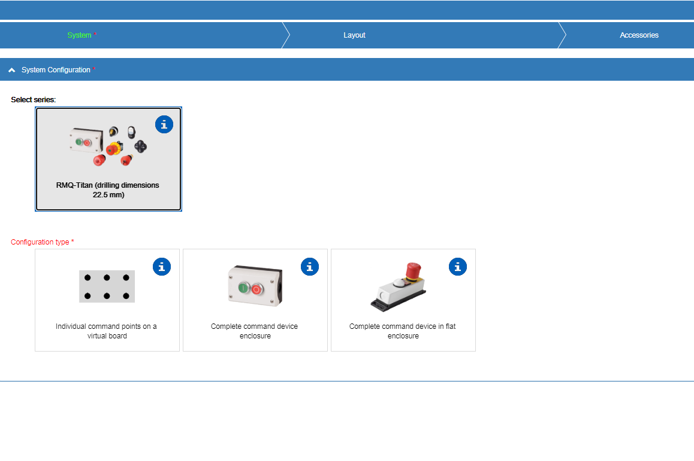
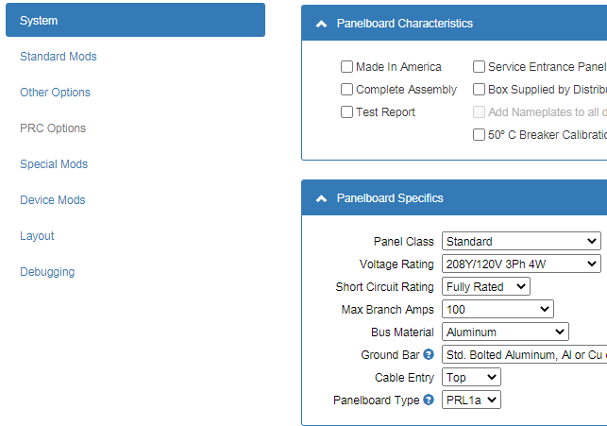
Bid Manager Current State
There are 200+ Bid Manager configurators (takeoffs) across Eaton
Bid Manager has 3 takeoff types – GTO, LGTO, Custom
Takeoffs are fully customized by the product lines (pick developer)
Lack of standards / governance across takeoffs
Differences in naming conventions, configuration flow, organization, outputs, etc.
User (internal / external) feedback prioritizes user interface improvements
Consistencies between takeoffs (reduce learning curve)
Mobile responsiveness

Slide 11
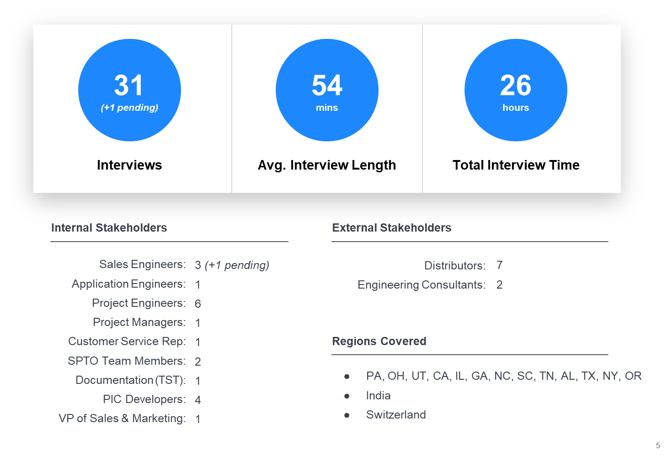
Bid Manager – User Surveys
Brought in a third party to conduct user interface surveys of Bid Manager with internal / external users globally
Key Findings
Treat everyone as new user
Reduce user burden / touchpoints
More flexibility / forgiving
Less user restrictions
Mobile responsiveness is missing
Take advantage of modern web

Slide 12
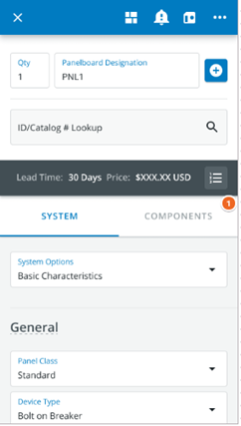
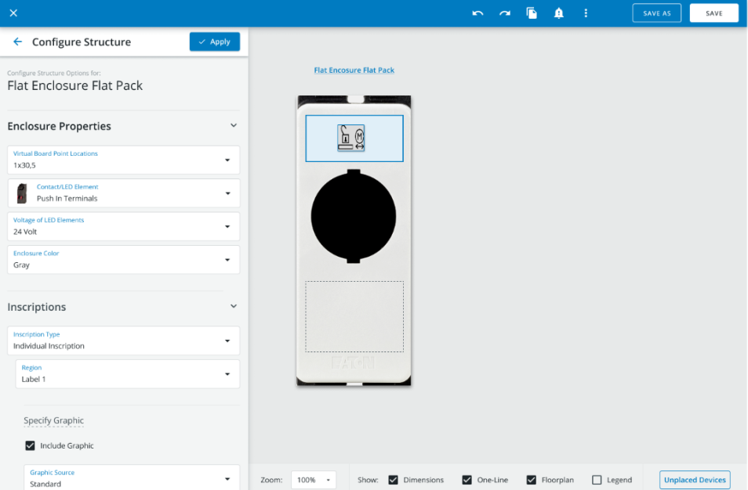
Bid Manager Future State
One global template for all Bid Manager takeoffs
Mobile responsive
Pick development standards /governance
Locked down templates, standardized naming conventions, etc.
Governance processes to manage global template changes

